Slide 1
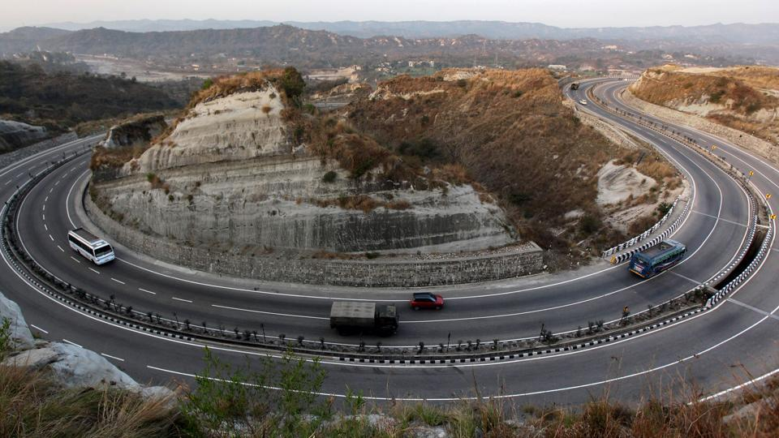
Transport Department
-Book
e

Slide 2
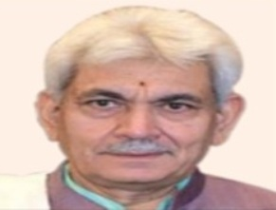
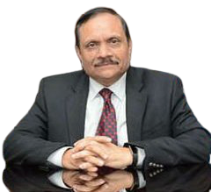
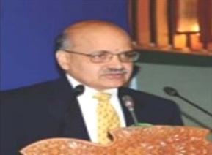
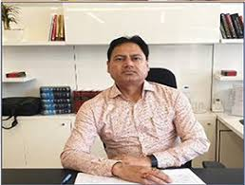
SHRI MANOJ SINHA
LIEUTENANT GOVERNOR
JAMMU & KASHMIR
SHRI RAJEEV RAI BHATNAGAR
ADVISOR TO LIEUTENANT GOVENOR
SHRI B.V.R. SUBRAHMANYAM, IAS
CHIEF SECRETARY
JAMMU & KASHMIR
SHRI HIRDESH KUMAR, IAS
COMMISSIONER/SECRETARY TO GOVERNMENT TRANSPORT DEPARTMENT

Slide 3
ADMINISTRATIVE DEPARTMENT
Name of the Officer | Designation | Phone No/Address
Sh. Hirdesh Kumar (IAS) | Commissioner/Secretary to Government | Telephone: 0191-2547935 (Jammu) Fax: 0191-257007 Telephone: 0194-2506077 (Srinagar) Fax: 0194-2506008 Civil Secretariat, Jammu/Srinagar. Ground Floor 40, Jammu.
Sh. P.S Rakhwal | Director Finance | Mob:- 9469212892 0191-2572984 (Tel/Fax) 0194-2506191 Sgr (Tel/Fax) Mail: dirfinance.tpt@jk.gov.in
Sh. Hakeem Muzaffar (KAS) | Deputy Secretary to Government | Mob: 9419056498
Sh. Raj Mohammad Malik (KAS) | Deputy Secretary to Government | Mob: 9419141806

Slide 4
TRANSPORT DEPARTMENT
Motor Vehicles Department
S. No. | Name of the Officer S/Shri | Designation | Mobile No. | E-Mail
01 | Pardeep Kumar, KAS | Transport Commissioner | 9419124121 | tptcommissionerjk@gmail.com
02 | Raman Kumar Kesar, KAS | Addl. Transport Commissioner | 9419157901 | tptcommissionerjk@gmail.com
03 | Gurmukh Singh, KAS | Jt Transport Commissioner | 9419114670 | tptcommissionerjk@gmail.com
04 | Shammi Kumar | Assistant Transport Commissioner | 9419197999 | tptcommissionerjk@gmail.com
Divisional Officers
05 | Akramullah Tak, KAS | RTO, Kashmir | 9419007503 | rtokashmir001@gmail.com
06 | Dhananter Singh, KAS | RTO, Jammu | 9419378117 | rtojammu@gmail.com
District Officers
07 | Raj Kumar Thapa, KAS | RTO, Kathua | 9419113832 | rtokathua2@gmail.com
08 | Neeraj Sharma | ARTO, Kathua | 9419198106 | rtokathua2@gmail.com
09 | Jugal Kishore | ARTO, Poonch | 9419172730 | artopoonch786@gmail.com
10 | Kuldeep Singh | ARTO, Doda. | 9419155505 | artododajmu@gmail.com
11 | Kuldeep Singh | ARTO. Kishtwar (Addl. Charge) | 9419155505 | artokishtwar@gmail.com
12 | Rachna Sharma | ARTO, Udhampur | 9596890711 | artoudhampur@gmail.com
13 | Mohd Saleem | ARTO Jammu (Headquarter) | 9419161281 | rtojammu@gmail.com
14 | Rehana Tabassum | ARTO, Samba | 9419214481 7006676738 | artosambajmu@gmail.com
15 | Esha Chib, KAS | ARTO BOI,(Passenger) | 9682395927 | rtojammu@gmail.com
16 | Pawan Sharma | ARTO BOI, (Goods) | 9419190101 | rtojammu@gmail.com
17 | Shafqat Majeed. | ARTO, Ramban. | 9419001745 | artorambanjmu@gmail.com
18 | Jamsheed Rasool | ARTO, Budgam. | 9419408131 | artobudgam1@gmail.com
19 | ARTO, Mauzzam Ali | ARTO Shopian and Addl. Charge. ARTO Pulwama | 9419017468 | artoshopiankmr@gmail.com artopulwamakmr@gmail.com
20 | Suhayab Ah. Wani. | ARTO, Bandipora | 7006706414 | artobandiporakashmir15@gmail.com
21 | Mubashir Jan. | ARTO, Baramulla | 9419006696 | artobaaramulla@gmail.com
22 | Mohd Zubair Latoo. | ARTO, Kulgam | 9797876251 | artokulgam59@gmail.com
23 | Inzar Ahmad Rana. | ARTO, Rajouri | 9419353405 | artorajourijmu@gmail.com
24 | Mukhtar Sofi. | ARTO, kupwara | 9419036888 | jk09kupwaraoffice@gmail.com
25 | Peerzada Shabir. | ARTO, Anantnag | 9419041634 | artoanantnagkmr@gmail.com
26 | Shiekh Manzoor. | ARTO, HQ, Kashmir | 9419009429 | rtokashmir001@gmail.com
27 | Arif Parveez Shah. | ARTO, Ganderbal | 9419066215 | artogbl16@gmail.com
28 | Wajahat Qayoom | ARTO Board of Inspection Srinagar | 9419000549 | rtokashmir001@gmail.com
29 | Rajesh Gupta | ARTO Reasi | 9419161373 | artoreasi2015@gmail.com
4

Slide 5
INTRODUCTION
Transport Department envisage providing economic, public friendly and eco-friendly mode of transport in the Union Territory of Jammu and Kashmir.
The department has following three (03) wings to provide services as indicated against each:-
Motor Vehicles Department
Commercial/ Non-Commercial Transport & Regulation
J&K Road Transport Corporation
Public Transport (Buses/Trucks)
State Motor Garages
LMVs for Govt. Offices
Interface with :
Civil & Police Administration
PWD/NHAI/BRO
Health Department
Urban Dev. Department

Slide 6
MAIN ACTIVITIES – IMPLEMENTATION OF MOTOR VEHICLES ACT/ RULES
Registration of Vehicles
Introduction of New Type of Vehicles.
Issuance of Letter of Authority
Issuance of Route Permits, National/State/District
Issuance of Licenses to Transport & Goods Booking Companies
Certification of Fitness of Vehicles.
Issuance of Driving Licenses.
Issuances of Licenses to Driving Schools/Institutes
Issuance of Trade Certificates to Automobile Dealers
Registration of Pollution Testing Centers.
Notification of Bus/Taxi/Auto Stands
Notifications of Fares to be charged by different categories of passenger vehicles.
Collecting Taxes/ Fines/ Fee
Road Safety Awareness
Safety is not automatic, think about it.
6

Slide 7
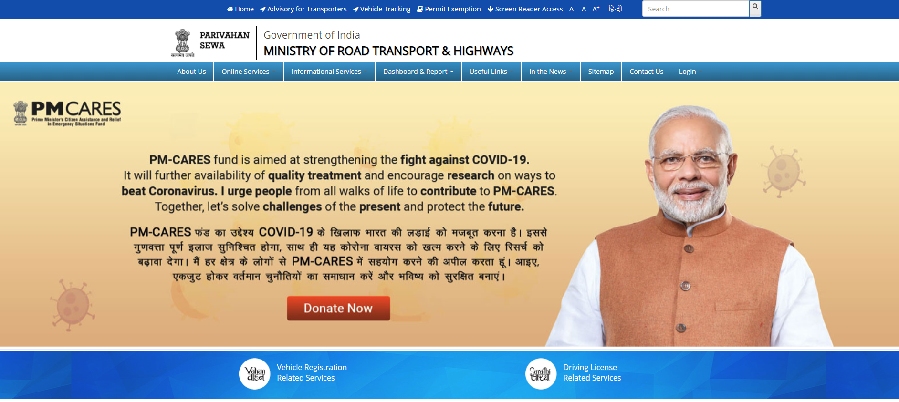
ONLINE SERVICES: PARIVAHAN SEWA
With the objective to improve the quality of service delivery, a uniform standardized software known as “VAHAN” for all vehicle related services and “SARATHI” for all Driving Licences related Services have been launched by MoRTH, GOI; which is also being implemented in Union Territory of Jammu and Kashmir.

Slide 8
ONLINE SERVICES: PARIVAHAN SEWA (CONTD.)
Registration of vehicles
Duplicate Registration Certificate
Correction in Registration Certificate
Transfer of Vehicles
Hypothecation Cancellation / Endorsement
Renewal of Route Permits
Fitness Certificate
Learner License
Renewal of Learner License
Driving License
Renewal of Driving License
Duplicate Driving License
Replacement of Driving License
Change of Biometrics in Driving License
Issuance of International Driving Permit
SARATHI
VAHAN
8

Slide 9
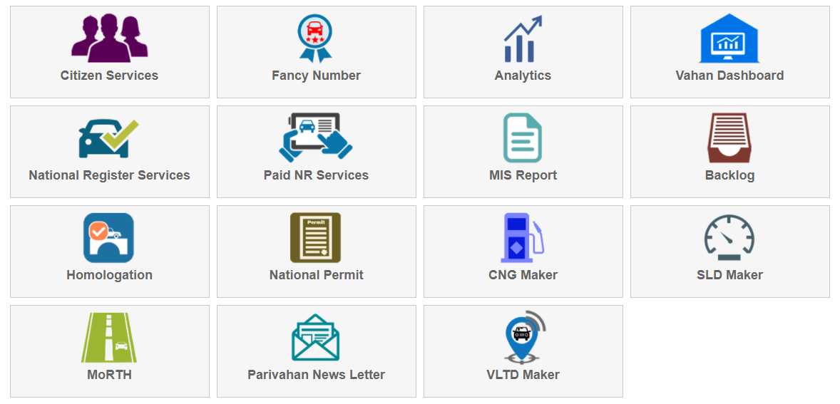
E-VAHAN

Slide 10
Registration
As per section 39 of Motor Vehicles Act, 1988, no person shall drive any motor vehicle and no owner of a motor vehicle shall cause or permit the vehicle to be driven in any public place or in any other place unless the vehicle is registered in accordance with this chapter and the certificate of registration of the vehicle has not been suspended or cancelled and the vehicle carries a registration mark displayed in the prescribed manner.
The system of registration of vehicle has been simplified and made public friendly by shifting the registration to Dealer Assisted Registration for
Non – Commercial Vehicles in the UT of Jammu & Kashmir.

Slide 11
DEALER ASSISTED REGISTRATION
Dealer Assisted Registration for Non-Commercial vehicles in the U.T of J&K started on 21.07.2020
Main Features
Authorized Automobile Dealer shall upload all documents related to the vehicle such as From No. 20, 21 and 22 Sale Invoice, Insurance Certificate, proofs of Fast Tag, Valid Address Proof of the purchaser and any other documents as prescribed by the CMVR 1989 or as asked by the Government, from time to time, on Vahan Portal;
All fees/tax depositing, generation of Registration Number and affixation of HSR Plates shall be done at dealers end;
Owner/Purchaser has not to pay any additional charges for allotment of Permanent Registration Number, depositing of online tax, fee and uploading of documents, cost of HSRP and processing of application etc;
Approval for Registration shall be completed by the Registering Authority i.e RTOs/ARTOs within 72 hours; and
No need to visit RTOs/ARTOs office for Registration related work of Non-Commercial vehicles.

Slide 12
SOP for Dealer Assisted Registration for Non- Commercial Vehicles
Non Transport Vehicles shall be issued permanent registration mark through VAHAN portal of Ministry of Road, Transport and Highways (MoRTH), Government of India, at the time of first sale by the dealers in the UT of Jammu and Kashmir.
No vehicle sold by the Dealer (Trade Certificate Holder) to any person shall be driven / taken out of showroom, unless a permanent registration mark is allotted to the vehicle by the Dealer through the VAHAN portal.
Each dealer shall be provided with a unique ‘login id and password’ in VAHAN portal by applying for the same on the prescribed form, which shall serve as his identification to access the portal of MoRTH.
The Dealer will take required documents for registration as per Rule 4 of Central Motor Vehicles Rules, 1989 from the vehicle owner duly self-attested by the owner of vehicle.
The Dealer shall enter the data related to the vehicle on the VAHAN portal. He shall enter the Chassis Number and all the details regarding Chassis shall be auto populated from the Homologation data base. (Homologation database is a repository of all vehicle models/variants manufactured by the vehicle Manufacturers in India, whose credentials are provided by Ministry of Road, Transport and Highways and National Informatics Centre).
Form No.20 shall be printed from the portal and the Dealer after inspecting the vehicle shall issue the Certificate of Inspection on the Performa, as prescribed in Form 20 and upload it on the VAHAN portal to satisfy the Registering Authority about the physical inspection of the vehicle.
The following documents (duly signed by the purchaser) and any other document as may be prescribed in the CMVR, 1989 or by the Government from time to time, shall be uploaded by the Dealer on VAHAN portal:-
Form No. 20 complete in all respects
Form No. 21 (Sale letter)
Form No. 22 (Road worthiness certificate)
Sale invoice
Valid address proof of the Purchaser as per Rule-4 of CMVR, 1989
Insurance certificate
Proof of fast tag
The relevant information and documents to be uploaded shall be duly verified by the Dealer and thereafter all the fees/taxes shall be deposited online in VAHAN portal. The fees/taxes shall include the following or any other fees/taxes as levied by the Government from time to time:-
Registration fee
Hypothecation fee, if applicable
Road Tax and cess etc
Registering Authorities (RTOs / ARTOs) shall verify the documents of the vehicles on the basis of the documents uploaded by the Dealer on the Vahan Portal. However, the onus of authenticity / genuineness of the documents uploaded on Vahan portal shall be the sole responsibility of the concerned Dealer.

Slide 13
Standard Operating Procedures (Contd.)
10. The registration mark shall automatically be generated after completion
of all the codal formalities, as prescribed above.
11. The Registration mark shall be placed by the Dealer on HSRP supplied by Manufacturer or selected vendor. The HSRP shall be affixed by the Dealer on the vehicle.
12. No additional charges/amount shall be realised by the Dealer from the purchaser of the vehicle for the allotment of permanent
registration number, deposition of online tax and fee, cost of HSRP and processing of application. The Dealer shall also
undertake to abide by all the terms and conditions issued in this behalf by the Department of Transport, Government of J&K,
from time to time and MoRTH, Government of India. In case of non compliance, violation or breach of any of the terms and
conditions, the Trade certificate of the Dealer shall be liable to be suspended/cancelled.
13. (a) The Dealer shall upload the parameters/laser codes of HSRP affixed on the vehicle, on VAHAN portal.
(b) RC will be issued by the Registering Authority only after the above (a) is performed by the Dealer.
(c) The permanent registration marks as generated by the VAHAN Portal, shall be assigned from the series allotted to the
concerned registering authorities/dealer. If the purchaser is willing to get a choice number/vanity number as mentioned in
Rule 54 {6(a)} of Jammu & Kashmir Motor Vehicles Rules, 1991, he shall deposit the requisite fees through the VAHAN
portal. After confirming the transaction, receipt shall be generated from the VAHAN portal for the purchaser.
14. During this process, the dealer shall also ensure that:-
The new vehicle has obtained type approval from the agency authorised under Rule 126 of the Central Motor Vehicles Rules, 1989 and from the Department of Transport, Jammu and Kashmir for registration of a vehicle of that model in the
UT of J&K, as per J&K Motor Vehicle Rules, 1991 and SROs / SOs as amended / issued from time to time.
The new vehicle to be delivered to the purchaser is not a stolen/re-sold vehicle. Further, the new vehicle is not mechanically defective and complies with the requirement of Motor Vehicles Act/Rules and instructions issued there under from time to time.
The purchaser/applicant has furnished accurate particulars in the application for the registration of the vehicle and has furnished all supporting documents issued by the competent authority as may be required and that there is no reason for the refusal of the registration of the vehicle.
Where the new motor vehicle is held under hire purchase agreement, lease, hypothecation with any Bank or finance company, the full name and address of the Bank or Finance company has to be incorporated legibly/prominently in Form No. 20 and 21.

Slide 14
Standard Operating Procedures (Contd.)
15. The authenticity/genuineness of the documents uploaded shall be the sole responsibility of the Dealer. In case, if any document
uploaded by Dealer including the inspection report of vehicle, is found at later stage fake, frivolous/forged/tempered, the
Dealer’s login ID on VAHAN portal shall be disabled immediately and the Trade Certificate of the Dealer shall get ipso facto
cancelled. Besides, he shall also be liable for prosecution under relevant provisions of law. The concerned Registering Authority
shall not in any way be responsible for authenticity/genuineness of all requisite documents uploaded on VAHAN portal by the
dealer, required for the issuance of Registration Certificate.
16. Permanent registration mark as allotted shall finally be approved by the concerned Registering Authority on the basis of
documents uploaded by the dealer on the VAHAN Portal and the approval shall be conveyed to the Dealer online within a
period of 72 hours from such uploading. Upon receipt of approval from the Registering Authority, the dealer shall generate the
print out of Registration Certificate carrying the scanned signature of the Registration Authority.
17. In order to maintain the security of data, the user will receive an OTP on their mobile phone at the time of login.
18. The Registering Authorities are authorised to inspect the records which are in possession of Dealer in case of any doubt with
regard to genuineness of all or any records and the dealer is bound to allow such inspection by Registering Authority as and
when required.
19. The Dealer should have a valid Trade certificate. In case of expiry of Trade Certificate, dealer will not be allowed to initiate the
process of registration in the system.
20. The original files, till further orders, shall remain in safe custody of the concerned dealer which can be called as and when
required by the transport authorities. In case of change/closure of business by the dealer, all the original files relating to
registration of vehicle shall be handed over to the concerned Registration Authority under proper receipt.
21. The Dealer shall indemnify, defend and protect the interests of the Government including its officers and employees against any,
all proceedings, actions and third party claims for any loss, damages, expenses of whatever kind arising out of the Registration
process. The Dealer shall fully indemnify and defend the Government including its officers and employees from and against any
and all losses and damages arising out of or with respect to failure of the Dealer to comply with applicable Laws, Rules and
Regulations.
22. This system shall not apply for registration of vehicles purchased through CSD, imported vehicles and for vehicles purchased
outside the UT of Jammu and Kashmir but being registered in the J&K, in which case they shall continue to be registered at the
level of the Registering Authority.
23. The dealer shall have to deposit a sum of Rs. 2 Lac interest free, as surety or bank guarantee which shall be refundable and
same can be forfeited in case of any violation of the terms and condition or loss to the state ex-chequer.
24. In order to maintain uniformity in the ex-showroom price of the vehicles in the UT of J&K the dealer shall display ex-
showroom prices on the board in the showroom.

Slide 15
OTHER ONLINE VAHAN SERVICES
Issuance of Duplicate Registration Certificate :
The applicant has to visit site www.parivahan.gov.in (Vahan portal) for applying online for issuance of Duplicate Registration Certificate and has to upload the following documents besides depositing requisite fee online:
FIR/Missing Report of concerned Police Station.
Newspaper publication cutting.
Undertaking by the applicant

Slide 16
OTHER ONLINE VAHAN SERVICES(Contd.)
Change of address in Registration Certificate:
The applicant has to visit site www.parivahan.gov.in (Vahan portal) for applying online by uploading any of the following documents as address proof besides depositing requisite fee online:
Domicile Certificate;
Aadhar Card;
Ration Card;
Electoral Roll;
Life Insurance Policy; and
Passport

Slide 17
OTHER ONLINE VAHAN SERVICES (contd.)
Renewal of Route Permit:
The applicant has to visit site www.parivahan.gov.in (Vahan portal) for applying renewal of Route Permit and has to deposit requisite fee online and upload the following documents:
Application Form
Registration Certificate
Fitness Certificate
Insurance
Passenger Tax receipt
Road/ Token Tax
Pollution Under Control Certificate
The earlier Route Permit has to be deposited in the RTO/ARTO office by the applicant or through representative or by registered post.

Slide 18
SARATHI SERVICES
Issuance of Learner License:
The applicant has to apply on www.parivahan.gov.in (Sarathi portal) and upload any of the following documents as address proof:
Aadhar Card,
Electoral Roll,
Life Insurance Policy,
Passport,
Pay slip issued by any office of the Central Government or a State Government or a local body
Further any of the following document has to be uploaded as proof of age:
Matriculation/ School Leaving Certificate
Date Of Birth Certificate issued by Registrar of Birth
Provided that where the applicant is not able to produce any of the above mentioned documents for sufficient reason, the licensing authority may accept any affidavit sworn by the applicant before an Executive Magistrate, or a First Class Judicial Magistrate or a Notary Public as evidence of age and address. (Besides, a self declaration as to the physical fitness as in Form-1 and medical certificate in Form 1-A issued by a registered medical practitioner is required to be provided for issuance of Learner License).

Slide 19
SARATHI SERVICES (Contd.)
Extension / Renewal of Learner License:
No test required for extending learner License therefore the candidate need not to visit the office. He/ She shall have to apply online on www.parivahan.com with uploading of fresh medical certificate and payment of requisite fee.

Slide 20
SARATHI SERVICES (contd.)
Driving License:
The applicant has to visit site www.parivahan.gov.in (Sarathi portal) for applying, payment of fee, uploading of Learner’s License and address proof and thereafter book slot/appointment date for appearing in the Driving Trial Test.

Slide 21
SARATHI SERVICES (contd.)
Renewal of Driving License:
Apply on www.parivahan.gov.in (Sarathi portal) and upload following documents:
Form 2/9
Driving License
Photograph (latest)
Self declaration as to the physical fitness as in Form-1 and medical certificate in Form-1A issued by a registered medical practitioner.

Slide 22
SARATHI SERVICES (contd.)
Issuance of Duplicate Driving License:
Apply on www.parivahan.gov.in (Sarathi portal) and upload following documents:
FIR/Missing Report of concerned Police Station.
Newspaper publication cutting.
Undertaking by the applicant.

Slide 23
SARATHI SERVICES (Contd.)
Replacement of Driving License:
Apply on www.parivahan.gov.in (Sarathi portal) and upload the Driving License to be replaced besides depositing requisite fee .
Subsequently, the applicant has to deposit the Old Driving License in the concerned RTO/ ARTO office personally or through representative or through registered post.
Change of Biometrics in Driving License:
Apply on www.parivahan.gov.in (Sarathi portal) and upload the relevant document.

Slide 24
Other Services
Motor Transport Service License
License from the Transport Authority is mandatory for operating Transport Service in the Union Territory. The License shall be issued in favour of the person or the company which meets the requisite eligibility criteria after payment of requisite fee as per Section 127 of MV Act, 1988.
How to Apply:
Applicant
Application
TRANSPORT COMMISIONER
For Reporting
RTO
ARTO/MVI
ARTO/MVI
Recommendation
RTO
Approval
TRANSPORT COMMISSIONER
License
Applicant
START:
24

Slide 25
Driving School/Institute
Any person/ registered society/company can establish driving school for imparting basic knowledge and skill of driving vehicles. The applicant is required to fulfil the eligibility criteria envisaged in Rule- 127 of J&K MV Rules, 1991 framed under MV Act, 1988.
How to Apply:
Applicant
Apply on Form No. 12
TRANSPORT
COMMISSIONER
For Reporting
RTO
Inspection
ARTO
Inspection Report
ARTO/MVI
Recommendation
RTO
For Approval
TRANSPORT
COMMISSIONER
Applicant
RTO
License
25

Slide 26
Trade Certificate:
Trade Certificate from the Registering Authority is mandatory for operating Automobile Dealership. The applicant is required to apply on Form-16 as envisaged in Rule-34 of Central Motor Vehicles Rules, 1989. The Trade Certificate holder has also to comply SRO -64 of 2012 dated 13.02.2012 read with Rule 274-A of Jammu and Kashmir Motor Vehicles Rule, 1991. Apply on www.parivahan.gov.in
How to Apply:
Applicant
Apply on
Form-16
RTO/ARTO
For Reporting
MVI
Recommendations
ARTO/MVI
Approval
RTO/ARTO
Trade Certificate on Form -17
Applicant
ARTO/MVI
Inspection
26

Slide 27
List of Documents required for issuance of Fresh Trade Certificate:
Form-16;
Letter of Intent (LOI) by Manufacturer;
Map/ Site Plan of showroom and workshop;
Partnership Deed, if any;
Domicile Certificate of owner/partners;
Voter Card/Aadhar of owner/partners;
PAN Cards of owner/partners;
PAN Card of firm;
Location of dealership and service station (on letter pad);
Photographs of dealership and service station;
Rent deed/Leased deed of dealership and service station;
Signatures of authorised signatories (on letter pad);
List of employees (on letter pad);
Registration of firm;
GST number of firm;
Certificate of incorporation by the Registrar of companies;
List of variants/models of Vehicles (on letter pad);
Memorandum of Association under the companies Act-2013;
Article of Association under the companies Act-2013;
List of board of Directors (on letter pad);
Liaison officer to be nominated with mobile no (on letter pad);
Notice in newspaper;
Passport size photographs of owner/partners;
Sample of letter head;
Approval orders of models;
Patent Certificate (in case of Electrical vehicles); and
Undertaking for compliance of SRO-64 of 2012 dated 13.02.2012 read with Rule 274-A of J&K Motor Vehicles Rules ,1991 and any other order/direction issued by Government/Transport department, from time to time.
27

Slide 28
Renewal of Trade Certificate:
The Automobile Dealer has to apply for renewal of Trade Certificate before the concerned Registering Authority as envisaged in Rule-35 of Central Motor Vehicles Rules, 1989. Apply on www.parivahan.gov.in
List of Documents Required:
List of models (on letter pad);
Manufacturer’s name and full address (on letter pad);
Authorised Signatory’s signature (on letter pad);
Detail of employees (both office and workshop) with designation (on letter pad);
Approval orders of ESC of new models/variants;
Photographs of office and workshop;
Original Trade Certificate; and
Certificate from manufacturer.
28

Slide 29
Pollution Checking /Testing Center
In order to check Vehicular pollution, every vehicle has to undergo the Pollution Under Control Checking from the authorized centre. The pollution checking centre can be established by a person having requisite space, technical know how and approved machinery as envisaged in Rule- 115 of Central Motor Vehicles Rules, 1989.
How to Apply:
Applicant
Application
TRANSPORT COMMISSIONER
For Reporting
RTO
Inspection
ARTO/MVI
For Inspection
ARTO/MVI
Recommendation
RTO
For Approval
TRANSPORT COMMISSIONER
License Authorization
Applicant
START:
29

Slide 30
VIOLATIONS OF MOTOR VEHICLES ACT/ RULES - PENALTIES
Offence
Fine/Penalty
General | Rs 500
Ticketless Travel | Rs 500
Disobedience of authorities orders | Rs 2,000
Unauthorized use of vehicles without license | Rs 5,000
Driving without license | Rs 5,000
Driving despite disqualification | Rs 10,000
Oversize Vehicles | Rs 5,000
Over Speeding | Rs 1,000 for LMV Rs 2,000 for Medium Passenger Vehicle
Dangerous Driving Penalty | Up to Rs 5,000
Drunken Driving | Rs 10,000
Speeding/Racing | Rs 5,000

Slide 31
VIOLATIONS OF MOTOR VEHICLES ACT/ RULES – PENALTIES (contd.)
Vehicle without Route Permit | Up to Rs 10,000
Aggregators (Violation of Licensing Condition) | Upto Rs 1,00,000
Overloading of goods | Rs 20,000 and Rs 2,000 per extra ton
Overloading of passengers | Rs 1,000 per extra passenger
Seat Belt | Rs 1,000
Overloading of two wheelers | Rs 2,000 disqualification for 3 months of license
Helmets | Rs 1,000 disqualification for 3 months of license
Not providing way for emergency vehicles | Rs 10,000
Driving without Insurance | Rs 2,000
Offences by Juveniles | Guardian/Owner shall be deemed to be guilty. Rs 25,000 with 3 years imprisonment
Power of officers to impound documents | Suspension of driving licenses u/s 183,184,185,189,190,194C,194D,194E
Offences committed by enforcing authorities | Twice the penalty under the relevant section

Slide 32
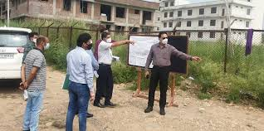
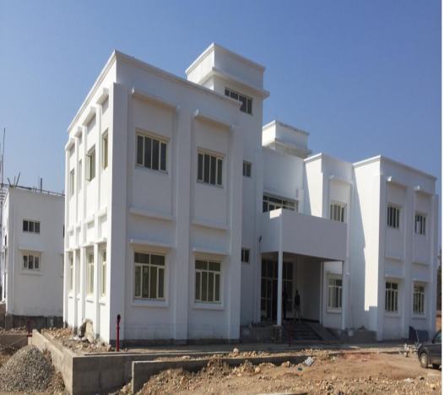
INITIATIVES TO MODERNIZE TRANSPORT DEPARTMENT
INSTITUTE OF DRIVING TRAINING AND RESEARCH (IDTR)
The State-of-Art IDTR, with estimated cost of Rs. 17 Cr sponsored fully, under Central Scheme by MoRTH, GOI is coming up in village Gaink, Kot-Balwal, Jammu.
It is established with an objective of providing training to the trainers, Instructors, Drivers of Heavy & Light Motor Vehicles and also of those who carry dangerous/hazardous goods.
2. The land for IDTR in Kashmir has been identified at Zoorigund- Budgam.

Slide 33
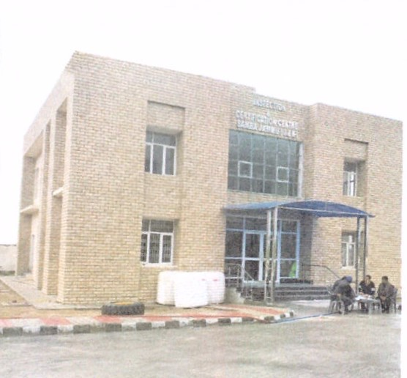
INITIATIVES TO MODERNIZE TRANSPORT DEPARTMENT (contd.)
3. INSPECTION AND CERTIFICATION CENTRE (ICC) SAMBA (JAMMU)
The State-of-Art ICC, with estimated cost of Rs. 14.40 Cr sponsored fully, under Central Scheme by MoRTH, GOI is coming up in village Bara Tehsil, Vijaypur, Jammu. Building completed, Equipment to be Installed Shortly.
The objective of the Centre is to conduct Scientific Inspection and Certification of fitness for commercial as well as private vehicles.

Slide 34
INITIATIVES TO MODERNIZE TRANSPORT DEPARTMENT (contd.)
4. THE JAMMU AND KASHMIR TRANSPORT SUBSIDY SCHEME
In order to give impetuous to the public transport and to promote new eco-friendly fuel efficient buses compliant with latest pollution standards and norms, the Government introduced this scheme in November 2019 . The scheme envisage provision of subsidy to the extent 5.00 lac or 16% of the cost of the vehicle (whichever is less) to vehicle honours replacing there old buses with new ones.
Proposal of number of buses have been received by the department and are being verified by the Technical Committee.
The scheme is being further liberalized to include more cases including mini buses: to give further impetus to eco friendly transport.

Slide 35
JAMMU & KASHMIR ROAD SAFETY COUNCIL
1. BACKGROUND :In Petition (civil) No. 295 of 2012 the Hon’ble Supreme Court acknowledged the importance and urgency of creating a structure for Road Safety.
2. The court directed that a State level Committee be constituted with following mandate
To measure and monitor, on behalf of Supreme Court , the implementation of various laws relating to Road Safety.
To identify the need for further legislation or changes in the existing laws.
35

Slide 36
JAMMU & KASHMIR ROAD SAFETY COUNCIL
3. The Supreme Court Committee on Road Safety was constituted which gave directions on following issues:
Road Safety policy
SRSC with Lead Agency
Road Safety Fund
Road Safety Action Plan
DRSC
Engineering Improvement
Traffic Calming measures
Road Safety Audit
Audit at Design level
Drivers Training
Lane Driving
Road safety Equipment
Alcohol and Road safety
Road Safety Education
Speed Governors
Emergency Medical Care
Accidental Helpline No.
Road Safety Cell
Data Collection (RADMS)
GPS
Body Building Code
ABS, Airbag and Headlights
4. In Order to implement directions, the Jammu and Kashmir Government has already constituted Jammu and Kashmir Road Safety Act, 2018 (Act No. 5 of 2018). Which provide for :
State Road Safety Council
Lead Agency
Road Safety Fund
DRSC
Punishments
36

Slide 37
Road Accident Victim Fund Rules, 2019
Notified vide Government Order No. 02-JK(TR) of 2020 dated 08-01-2020 Road Accident Victim Fund Rules, 2019 have been notified for providing immediate succour to the dependents/kith and kins /legal heirs of the persons killed / injured in road accidents These rules shall also be applicable to Hit and Run cases, passenger victims and road users / pedestrians.
Salient features of Road Accident Victim Fund Rules, 2019:
Compensation on account of Death : Rs. 1,00,000.00
Compensation on account of Permanent Disability : Rs. 75,000.00
Compensation on account of Grievous Injury : Rs. 50,000.00
Compensation on account of Minor Injury: Rs. 10,000.00

Slide 38
Road Accident Data Management System (RADMS)
In order to collect and analyse Data related to accidents, an Application namely Road Accident Data Management System (RADMS) developed NIELIT is being used in our Union Territory with it’s ,main data Processing Centre functioning in the office of Transport Commissioner, Rail Head Jammu. The data is collected on this Web- Based Application which is connected with the Central Office and analyzed to identify major causes of accidents
1
2
3
4
Road accidents have a definite impact in terms of lives , welfare and traffic congestion especially with increase in mobility and number of overall vehicles.
RADMS is a fully integrated web-based application that can be used for scientific road safety management. The application is completely GIS based facilitating officers to click accident spot picture.
RADMS is backed by a powerful GIS engine that supports multiple GIS accident data on digital maps and enables In-Depth GIS based accident black spot identification.
RADMS Provides road accident data to the stakeholders which in turn enables them to perform an In-Depth Analysis using different visualization techniques like graphical analysis tabular compilation and conclusive observation.

Slide 39
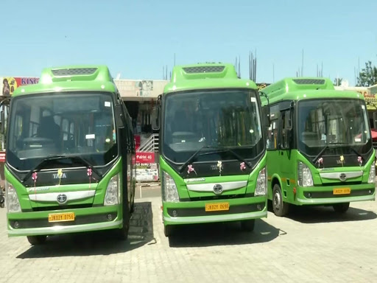
JAMMU AND KASHMIR ROAD TRANSPORT COORPORATIPON
AT A GLANCE
Established on 1st Sept. 1976 under the Road Transport Act, 1950
Previously a Government Transport Undertaking (GTU) established in Jan 1948
Staff Strength – 2051
Fleet – 854
Coverage (appx.) 2019-20
15 lakh km/month
3.8 lakh passengers/month
3.15 lakh Qtls cargo/month
JKRTC

Slide 40
J&K Road Transport Corporation
S.No | Name | Designation | Mobile No.
1 | Angrez Singh Raina | Managing Director | 9419114673
2 | J.S.Tandon | Joint Managing Director | 9419107061
Finance
1 | Nidhi Gupta | Financial Advisor & CAO | 9906267919
2 | Mohd Shafi | Manager (Finance) | 9419401119
3 | Naresh Sawhney | Divisional Accounts Officer, Jammu | 9419132063
4 | Peer Rafiq Ahmad | Divisional Accounts Officer, Srinagar | 9419016841
Administration
1 | Hafiz Ahmad | Dy.General Manager (Admn) | 9596508530
Planning
1 | Farhat Jan | General Manager (Planning), Srinagar | 9419011594
2 | Ravinder Singh Salathia | Assistant Director (Planning), Jammu | 9419237988
Load/Cargo
1 | Farhat Jan | General Manager (Load), Srinagar | 9419011594
2 | Sudesh Gupta | General Manager (Load) Jammu | 9419158489
3 | Mohinesh Arora | Traffic Manager (Load), Jammu | 9419828894
4 | Mohd Yaqoob | Traffic Manager (Load), Srinagar | 9419573961
40

Slide 41
J&K Road Transport Corporation
Operations
1 | Swarn Singh | General Manager (Operations) Jammu | 9596623333
2 | Syed Arshad Tramboo | General Manager (Operations) Kashmir | 9419088970
3 | Habibullah Reshi | Dy.General Manager (DSU/E-Buses) Kashmir | 7298522480
4 | M.K.Magray | Manager Passenger Services, Srinagar | 8803727166
5 | Pawandeep Singh | Manager Inter-State Services, Jammu | 7780987099
6 | Abdul Hamid | Manager Tourist Services, Srinagar | 9419003322
7 | Vivek Hans | Manager Tourist/District Services, Jammu | 9086049814
8 | Ahfaq Hussain | Depot Manager Anantnag | 9419713856
9 | Vijay Kumar | Depot Manager Pathankot/ Incharge TCP Lakhanpur | 9419208232
10 | Mohammad Hussain | Depot Manager, Kargil | 9469776503
11 | Dalip Razdan | Incharge Depot, Leh | 9419016968
12 | Deepak Abrol | Incharge Depot, Katra | 7006676060
13 | Mohd Kameel | Incharge Depot, Rajouri | 8082107474
14 | Mumtaz Ahmed | Incharge Depot, Poonch | 9797648971
15 | Dailip Aima | Incharge Depot, Doda/Kishtwar/Ramban | 9419682243
16 | Mohd Ashraf | Incharge Depot, Ramban | 9697660367
17 | Mushtaq Ahmed | Incharge Depot, Baramulla | 9596527699
18 | Bashir Ahmed | Incharge Depot, Supore | 7889913204
19 | GM Shafi | Incharge Depot, Kupwara | 6005198703
20 | Noor Mohammad | Incharge City Services, Srinagar | 7889666302
41

Slide 42
AIM AND OBJECTIVE
AFFORDABLE
1
CONVENIENT
2
Transport Service
RELIABLE
3
READILY AVAILABLE DEDICATED
4
MOVEMENT OF MEN AND MATERIAL DURING DISASTERS
5

Slide 43
J&K RTC E-BUSES
40 NOs. of E-buses have been introduced in first phase in the year 2019 by JK RTC 20 Nos. in Jammu & 20 Nos. in Srinagar District. E-Buses as advanced technology is being adopted to reduce air/ noise pollution. The department is in process to increase the E-buses fleet.
43

Slide 44
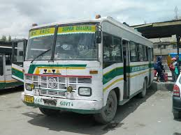
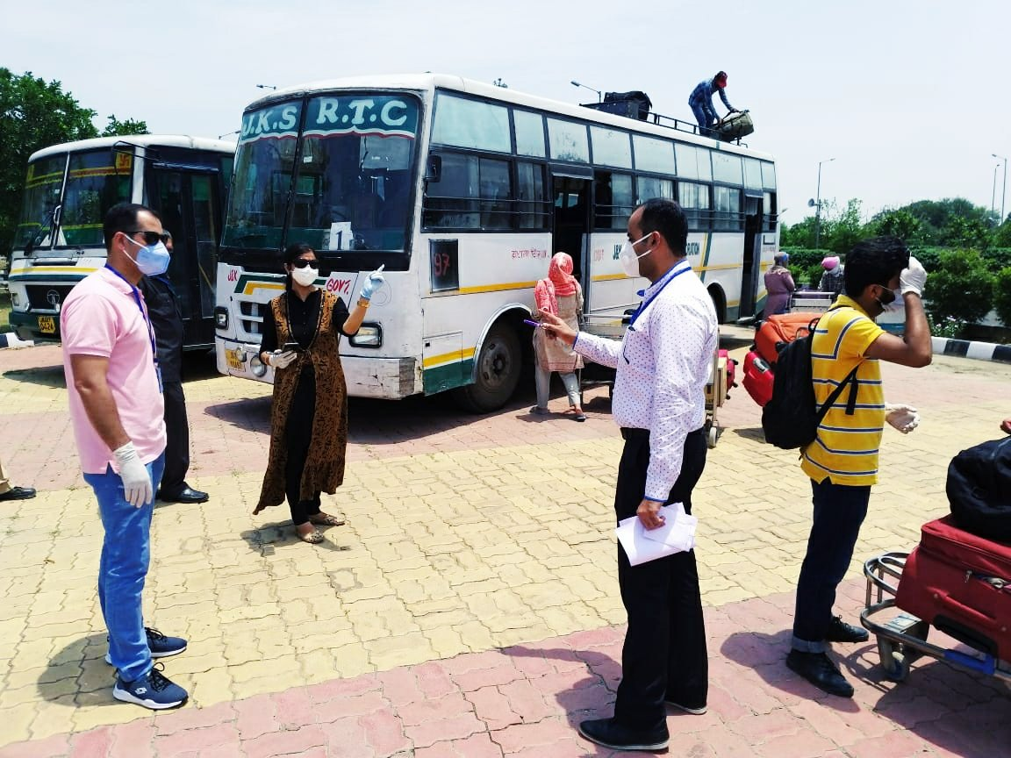
CHENAB VALLEY BUS SERVICE COVID-19 DUTIES
33 Nos. of buses have been added to JKRTC fleet exclusively to cater the demand of Doda / Ramban/ Kishtwar districts, Named as Chenab Valley Service. The main objective of the additional is to minimize the being accident prone area.
44

Slide 45
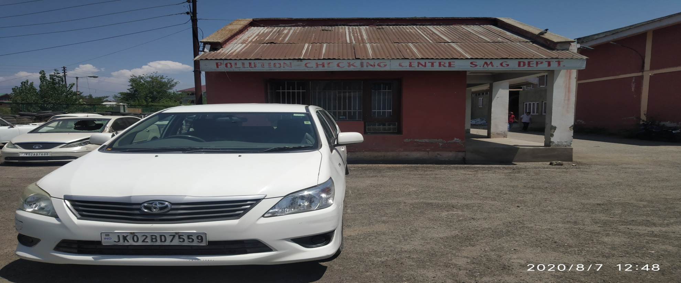
STATE MOTOR GARAGES
Sh. Zakir Hussain Choudhary
Director SMG
Ph. (Fax) - 0194-2490473 (May-Oct.), 0191-2565105 (Nov.-April)
Ph. (o) - 0194-2493309 (Kashmir), 0191-2546697 (Jammu)
email - dirsmg@gmail.com
Sh. Tahir Malik
Dy. Director SMG
45

Slide 46
List Of Officers Motor Garages Department
S.No | Name | Designation | Mobile Number
1 | Z. H. Choudhary | Director | 9419208155
2 | Malik Tahir Gani | Deputy Director, Jammu | 9419000778
3 | Syed Maurif Andrabi | Deputy Director, Kashmir | 9419017052
4 | Mohammad Munawar Khawaja | Administrative Officer | 9419063385
5 | P.K. Bhat | Accounts Officer | 9419632180
46

